Slide 1

JCOIN LEAP PARTICIPANTS
NIDA JCOIN Steering Committee Meeting
April 12, 2023

Slide 2
2022-2023 LEAP SCHOLAR Participants

Slide 3
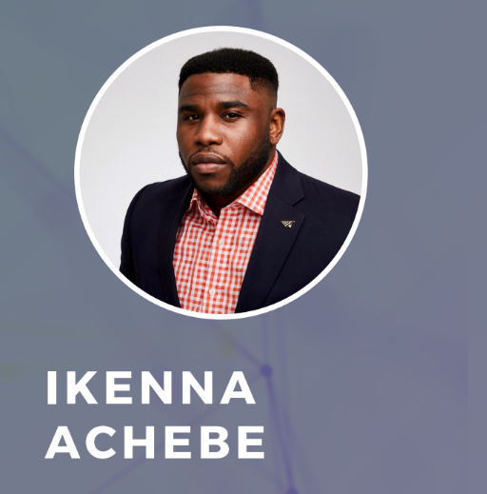

Ikenna Achebe is a Program Associate
at the Center for Behavioral and Youth
Justice at the Division of Child and
Adolescent Psychiatry at Columbia
University and an Adjunct Assistant
Professor for the Freedom Prep
Program at the City University of New
York (CUNY), a program that offers
justice-involved young people the
opportunity to take introductory
college courses and supports transition
to college degree programs.

Slide 4
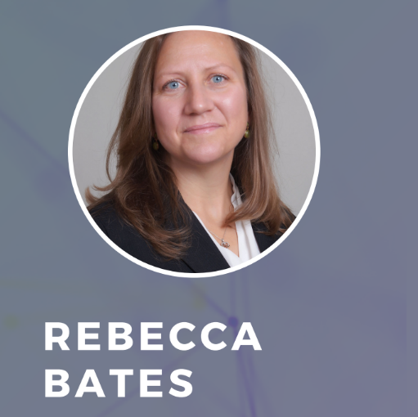
Rebecca Bates is passionate about
providing healthcare for vulnerable
populations and believes healthcare is a right for all. She is the technical
assistance (TA) program manager at A
Division for Advancing Prevention and
Treatment (ADAPT) and provides TA for substance use prevention and treatment programs in High Intensity Drug Trafficking Areas (HIDTAs) across the U.S. She also manages federally funded implementation grants in primary care clinics and with justice involved youth.

Slide 5
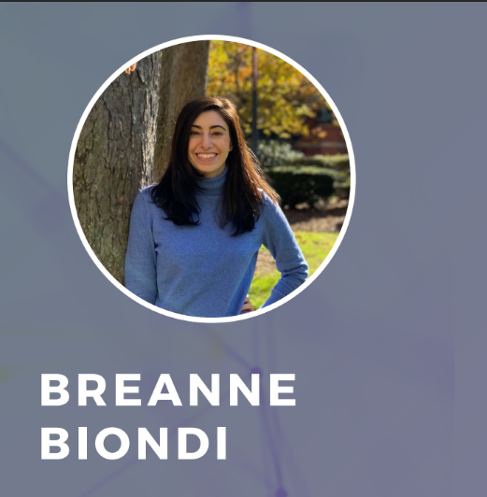
Breanne Biondi is a PhD student in
Health Services and Policy Research at
Boston University School of Public
Health (BUSPH).
She is a predoctoral fellow in the Integrated Care for Addiction, HIV, and HCV Research and Education NIDA-funded T32 training program. In addition, Breanne is a member of the Medicaid Policy Lab at BUSPH.

Slide 6
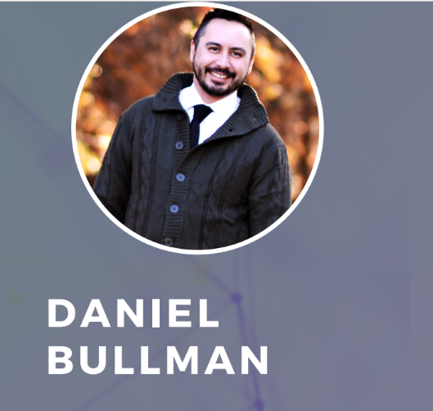
Daniel Bullman is a certified
community health worker/peer
recovery specialist and has been
previously recognized by the City of Indianapolis and the Ball State
University Alumni Association for his work addressing placemaking,
healthcare access, and food insecurity in Central Indiana.

Slide 7
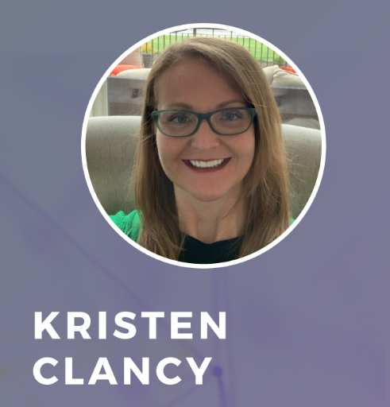
Dr. Kristen M. Clancy, PharmD, MHA, has worked or volunteered for non-profit organizations in public health
and safety for over 20 years, her entire professional career.
Dr. Clancy is the founder and Director of Rx Recovery, a non-profit organization whose mission is to help patients obtain their prescription medications (especially MAT) through
logistics, education and collaboration.

Slide 8

Morgan Maner is a first-year medical
student at the Brody School of
Medicine at East Carolina University.
Broadly, her current research interests
include health equity and how the
criminal-legal involvement manifests
as a structural determinant of health.
Morgan served as project coordinator at the UNC School of Medicine’s Re-Envisioning Health and Justice Lab, where she managed the RADx-Up grant to study COVID-19 transmission in carceral settings.

Slide 9

Madeline McPherson, M.S. , is a PhD student in the Department of
Criminology, Law & Society at George
Mason University. Madeline is a former justice practitioner having worked in policy and legislative affairs for the
Pennsylvania Department of
Corrections and the International
Association of Chiefs of Police.
Her research interests center on
corrections policy and practice with a
focus on improving carceral systems
and quality of life outcomes.

Slide 10
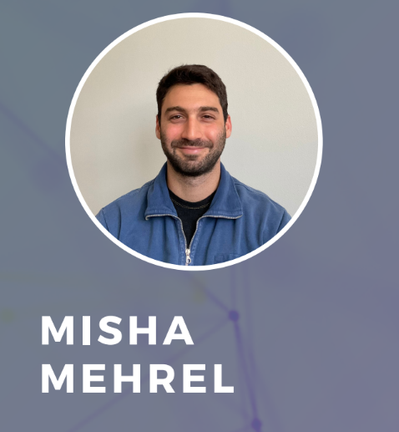
After working as an editor, Misha
gravitated towards more hands-on
social justice initiatives. This led to his studies at Smith College’s SSW. He has since worked as a full-time clinical intern at a methadone clinic in Seattle with their sentenced King County Drug Court clients, and in September of 2021 he began at Franklin County’s Sheriff’s
office as a clinical intern providing
casework and psychotherapy for
inmates.

Slide 11
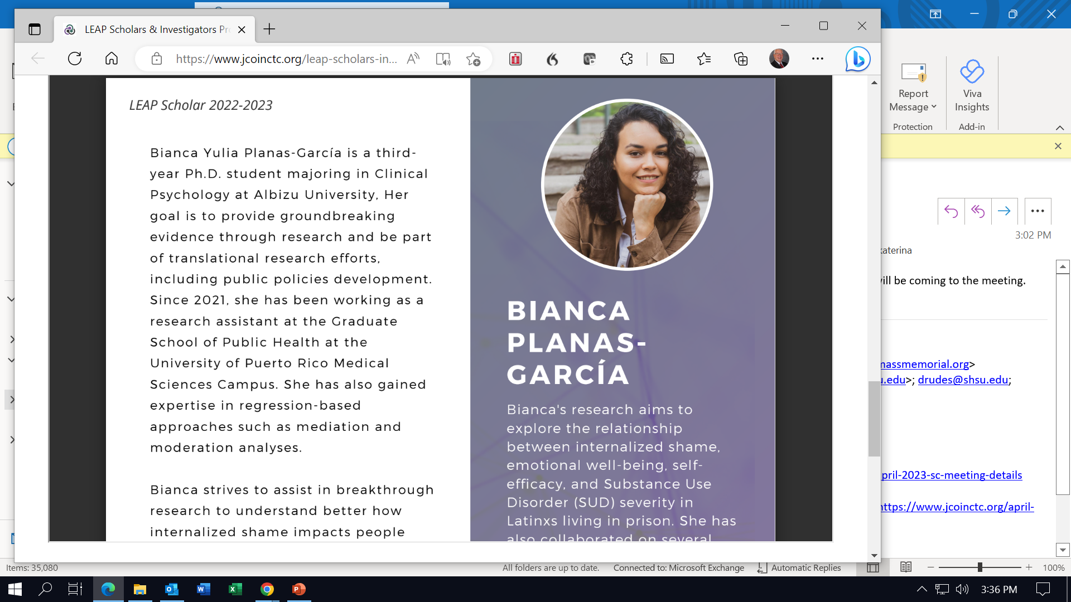
Bianca Yulia Planas-García is a third-
year Ph.D. student majoring in Clinical
Psychology at Albizu University, Her
goal is to provide groundbreaking
evidence through research and be part
of translational research efforts,
including public policies development.
Since 2021, she has been working as a
research assistant at the Graduate
School of Public Health at the
University of Puerto Rico Medical
Sciences Campus.

Slide 12
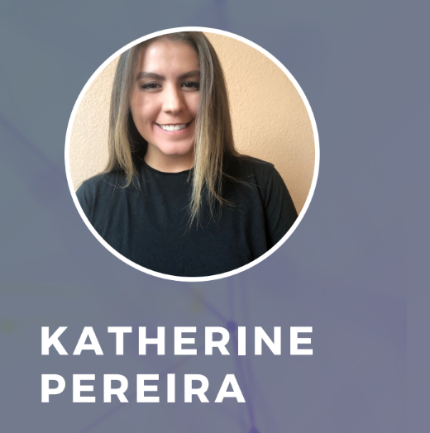
Katherine (Katie) Pereira is a second-
year clinical psychology PhD student at
University of Wisconsin-Madison. She is
Native Hawaiian but grew up outside of Washington D.C. in Northern Virginia.
She received her received her master’s
degree in psychology at University of
Wisconsin-Madison. Through various
research projects and clinical work, she
has worked with people struggling
with a variety of mental health issues.

Slide 13

In his various roles as a former Trainer,
Client Services Specialist, Veteran’s
Advocate, Case Manager and
Facilitator, Mancy brings with him, from both a professional and
personal level, an understanding of the
unique challenges many clients face on
a daily basis. He has incorporated his
educational training as a Credentialed
Substance Abuse Counselor along with his Credential in Family Development to assist program participants to become more self-sufficient.

Slide 14
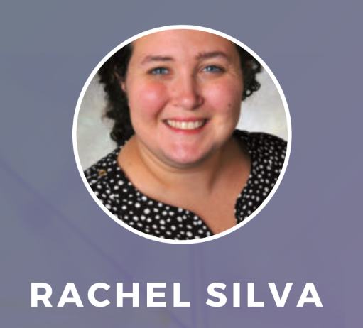
During Rachel Silva's initial decade of
work in medicine from residency
training to her current role as medical
director of the Hennepin County Jail,
the largest jail in the state on
Minnesota, she has worked clinically
with patients experiencing
incarceration. In this work, she has had
the opportunity to learn from patients
about the challenges incarcerated
patients face when seeking healthcare
inside jail and once they return to the
community.

Slide 15
2021-2022 LEAP INVESTIGATOR
Participants

Slide 16
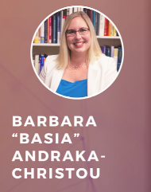
Basia is an Assistant Professor in the School of Global Health Management and Informatics, with a Joint Secondary Appointment in the Department of Internal Medicine, at the University of Central Florida (UCF). She is also a licensed attorney in Florida. Her research explores substance use disorder treatment from health services and health policy perspectives. Much of her work focuses on improving access to medications for opioid use disorder, including in problem-solving courts.

Slide 17
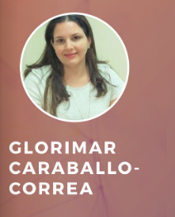
Glorimar Caraballo-Correa, PhD is an Adjunct Professor and Evaluator at the Graduate School of Public Health at University of Puerto Rico. Her research work and interest are focused on health services access and utilization, transition of care from prison to community, and stigma towards vulnerable populations such as drug users and incarcerated persons. Expansion of MOUD is one of her main research interests.

Slide 18
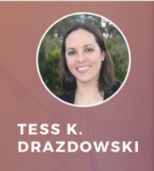
Tess is an early career investigator and clinical psychologist at the Oregon Social Learning Center. Most recently, her research has concentrated on the misuse of prescription drugs, cannabis, and polysubstance use with a strong focus on emerging adults. She is interested in investigating how to improve access to evidence-based practices for youth and young adults with substance use and mental health problems.

Slide 19
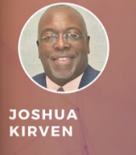
Joshua Kirven is an associate professor in the Department of Social Work at Winthrop University. He is a research-practitioner with twenty years of experience as an educator. Dr. Kirven's research areas are fatherhood, neighborhood leadership and safety, public health, youth development and social entrepreneurism.

Slide 20
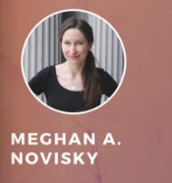
Dr. Novisky received her Ph.D. in Sociology from Kent State University in 2016. Her research investigates the implications of carceral contact on health and well-being, conditions of confinement, and criminal justice policy. In addition to her research experience, Dr. Novisky has an extensive background in applied criminal justice. She has worked with the University of Cincinnati's Corrections Institute (UCCI) since 2009 as an evidence-based programming consultant and trainer and she managed a rape crisis center for several years prior to joining the UCCI.

Slide 21
2022-2023 LEAP INVESTIGATOR
Participants

Slide 22
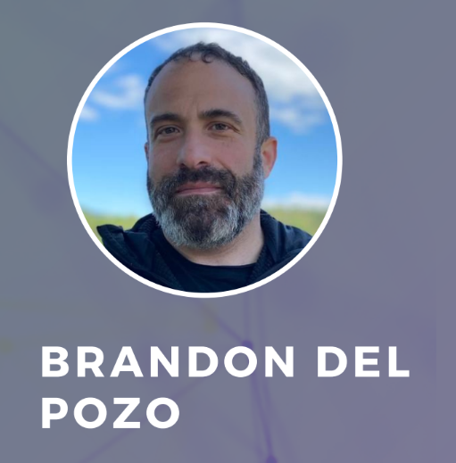
Brandon served for 23 years as a police
officer. His work created a desire in him to improve police response to SUD. He partnered with researchers nationally to devise evidence-based
strategies centering on harm reduction
and the widespread, low-threshold
availability of MOUD. After PhD work on the role of the police in a democracy, Brandon was inspired to further pursue the science needed to address the overdose crisis: MOUD is effective at saving lives but remain greatly underutilized.

Slide 23
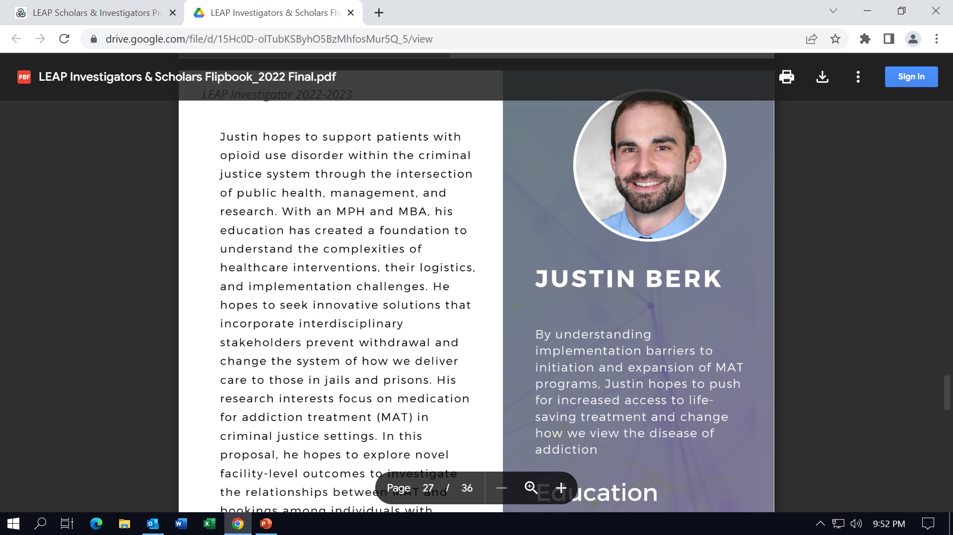
Justin hopes to support patients with
opioid use disorder within the criminal
justice system through the intersection
of public health, management, and
research. With an MPH and MBA, his
education has created a foundation to
understand the complexities of
healthcare interventions, logistics,
and implementation challenges. He
seeks innovative solutions to prevent withdrawal and change the system of how we deliver care to those in jails and prisons.

Slide 24
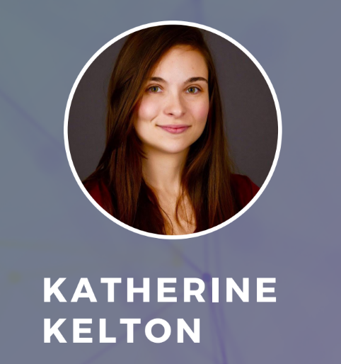
Katherine is an interdisciplinary, multi-
methods researcher with broad interests in how sociocultural, systemic inequities impact mental health.
Informed by her experience as a clinical psychologist and public health lens, topics have spanned incarceration, homelessness, substance use, and PTSD. She has worked in
multiple capacities across the
continuum of the criminal legal
system, including diversion programs,
specialty courts, jail, prison, reentry,
and community corrections.

Slide 25
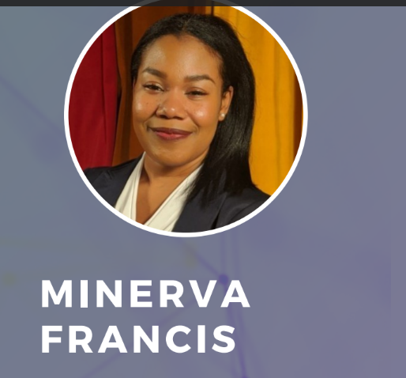
Minerva hopes to explore the
intersection of criminal justice
involvement and substance use
impacts family cohesion and
functioning. Her research centers on health equity and improved health outcomes. Most recently, she co-authored a manuscript on coping strategies for managing treatment among people of color living with HIV while simultaneously focusing on the
intersection of marijuana prohibition,
police encounters, and police violence.

Slide 26
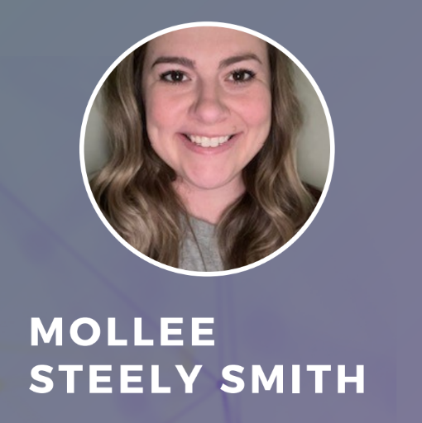
Mollee's research focuses on specialty
populations in prisons and corresponding treatment services. She
completed her Doctoral work with
the Arkansas DOC in the Research and Planning Division, where she trained in mixed methodologies, data management, and program evaluation. She led evaluation for the substance use treatment program. Throughout the evaluation, the need for education and implementation of evidence-based
practices became clear.

Slide 27
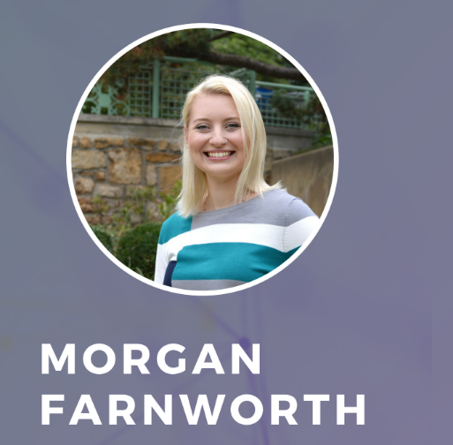
Morgan Farnworth is a PhD student in
public administration specializing in
urban health and public policy. Her
doctoral training shaped her research agenda, focused on understanding government as a determinant of health. Her research applies an
interdisciplinary lens to understand
facets of the overdose crisis,
including its relationship to local
health indicators, state policy
responses, and the potential of
collaboration between courts and
treatment sector.

Slide 28
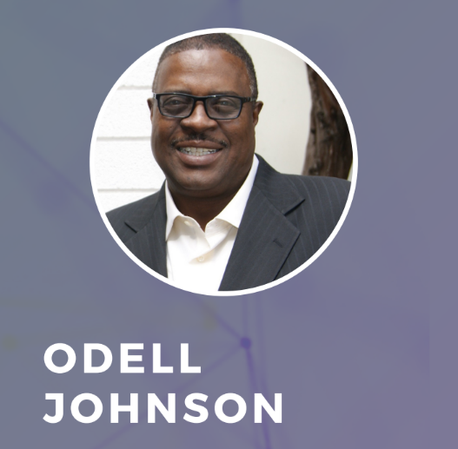
During his Ph.D. program, Odell worked as a research associate to address the homelessness of 3000 participants who frequent psychiatric centers, hospitals, and jails. Additionally, he served as lead investigator for a study aimed at
understanding how Fair Chance Hiring
(FCH) practices impact the lives of
those who have experienced substance use, crime, incarceration, reentry, and employment in succession.

Slide 29
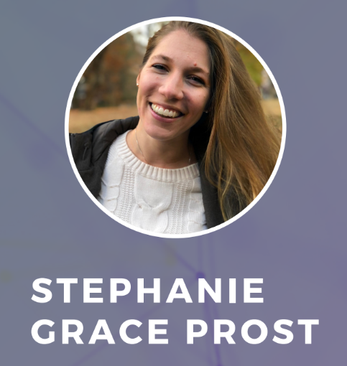
Stephanie is interested in describing the health and quality of life of older
adults who are incarcerated. Her
studies contributed to reporting
significant cohort effects regarding
health among older men, distinct risks of post-traumatic stress across varying forms of interpersonal victimization among older women, and health- related consequences of trust among older men. She is interested in examining approaches to care for older persons with life-limiting illness who are incarcerated.

